Slide 1
Learning the Semantics of Structured Data Sources
Mohsen Taheriyan
Department of Computer Science
Information Sciences Institute
USC Viterbi School of Engineering
Dissertation Committee
Craig Knoblock (PhD Advisor)
Cyrus Shahabi
Pedro Szekely
Viktor Prasanna (EE Department)

Slide 2
Motivation
Explicit semantics is missing in many of the structured sources
Employee? CEO?
 | name | date | city | state | workplace
1 | Fred Collins | Oct 1959 | Seattle | WA | Microsoft
2 | Tina Peterson | May 1980 | New York | NY | Google
Person?
Organization?
Birth date?
Death date?
Employment date?
Birth city?
Work city?
How to express the intended meaning of data?

Slide 3
Map the Source to the Domain Ontology
Describe sources using classes & relationships in an ontology
bornIn
nearby
birthdate
livesIn
isPartOf
Domain
Ontology
Place
Person
name
organizer
location
postalCode
name
ceo
City
State
worksFor
Event
state
Organization
title
endDate
phone
startDate
object property
data property
name
subClassOf
Source
 | name | date | city | state | workplace
1 | Fred Collins | Oct 1959 | Seattle | WA | Microsoft
2 | Tina Peterson | May 1980 | New York | NY | Google

Slide 4
Semantic Types
Person
Person
City
State
Organization
name
birthdate
name
name
name
 | name | date | city | state | workplace
1 | Fred Collins | Oct 1959 | Seattle | WA | Microsoft
2 | Tina Peterson | May 1980 | New York | NY | Google

Slide 5
Relationships
worksFor
bornIn
state
Person
City
State
Organization
name
birthdate
name
name
name
 | name | date | city | state | workplace
1 | Fred Collins | Oct 1959 | Seattle | WA | Microsoft
2 | Tina Peterson | May 1980 | New York | NY | Google

Slide 6
Semantic Model
worksFor
bornIn
state
Person
City
State
Organization
name
birthdate
name
name
name
 | name | date | city | state | workplace
1 | Fred Collins | Oct 1959 | Seattle | WA | Microsoft
2 | Tina Peterson | May 1980 | New York | NY | Google
Source discovery
Data integration
Publish knowledge graphs
Key ingredient to automate

Slide 7
Problem: How to automate building semantic models for structured sources?

Slide 8
Thesis Statement
The knowledge of previously modeled sources as well as the semantic data available in the Linked Open Data (LOD) cloud can be leveraged to learn accurate semantic models of structured data sources, enabling automated source discovery and data integration.

Slide 9
Outline
Semi-automatically building semantic models
Learning semantics models from known models
Inferring semantic relations from LOD
Related Work
Discussion & Future Work

Slide 10
Semi-automatically Building Semantic Models
Contribution: a graph-based approach to
extract implicit relationships

Slide 11


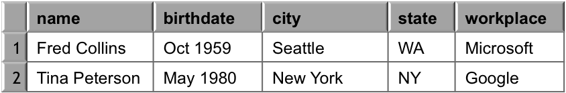
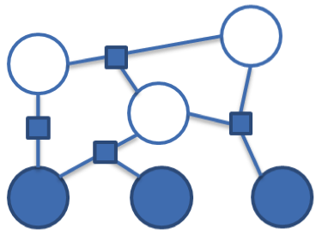
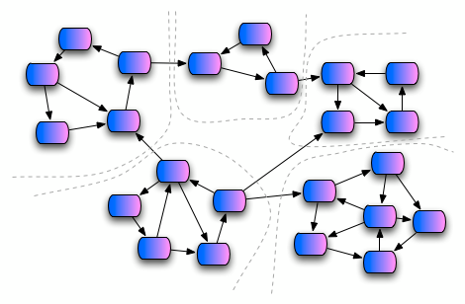
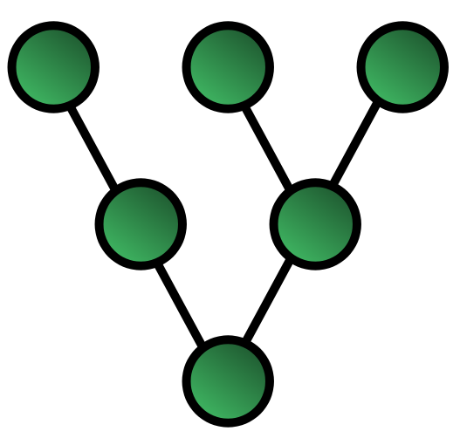
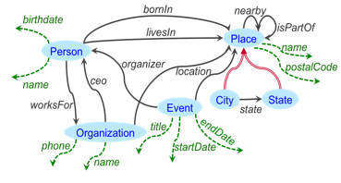


Approach [Knoblock et al, ESWC 2012]
Sample Data
Steiner Tree
Learn
Semantic Types
Extract
Relationships
Construct a Graph
Domain Ontology
Implemented in Karma
http://www.isi.edu/integration/karma
@KarmaSemWeb

Slide 12
Karma
Interactive tool for rapidly extracting, cleaning, transforming, integrating and publishing data
Tabular
Sources
RDF
Database
Hierarchical Sources
Karma
CSV
Services
…
http://www.isi.edu/integration/karma
@KarmaSemWeb

Slide 13
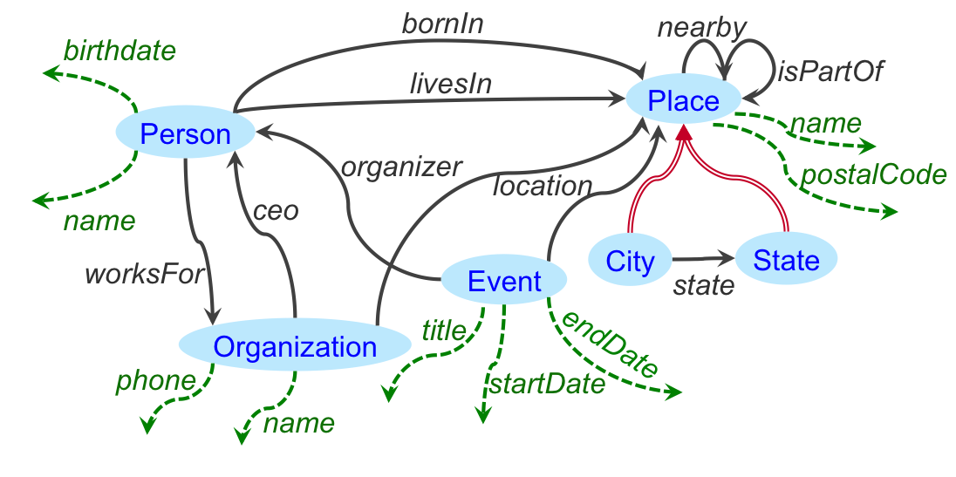
Example
Source
 | name | date | city | state | workplace
1 | Fred Collins | Oct 1959 | Seattle | WA | Microsoft
2 | Tina Peterson | May 1980 | New York | NY | Google
Domain Ontology
object property
data property
subClassOf
Goal: Find a semantic model for the source
(map the source to the ontology)

Slide 14
Learning Semantic Types [Krishnamurthy et al., ESWC 2015]
class?
property ?
workplace
Google
Microsoft
Amazon
…

Slide 15
Learning Semantic Types
Organization
1. User Specifies
name
2. Systems learns
workplace
Google
Microsoft
Amazon
…

Slide 16
Learning Semantic Types
Organization
name
workplace
Google
Microsoft
Amazon
…
employer
Facebook
Apple
Google
…

Slide 17
Learning Semantic Types
Organization
Organization
name
name
workplace
Google
Microsoft
Amazon
…
employer
Facebook
Apple
Google
…

Slide 18
Semantic Labeling Approach
Each semantic type: label
Each data column: document
Textual Data
Compute TF/IDF vectors for documents
Compare documents using Cosine Similarity between TF/IDF vectors
Numeric Data
Use Statistical Hypothesis Testing
Intuition: distribution of values in different semantic types is different, e.g., temperature vs. population
Return Top-k suggestions based on the confidence scores

Slide 19
Construct a Graph
Construct a graph from semantic types and ontology
Person
Person
City
State
Organization
name
birthdate
name
name
name
 | name | date | city | state | workplace
1 | Fred Collins | Oct 1959 | Seattle | WA | Microsoft
2 | Tina Peterson | May 1980 | New York | NY | Google

Slide 20
Construct a Graph
Construct a graph from semantic types and ontology
date

Slide 21
Inferring the Relationships
Search for minimal explanation
Steiner tree connecting semantic types over ontology graph
Given graph G=(V,E), nodes S ⊂ V, cost c: E →ℜ
Find a tree of G that spans S with minimal total cost
Unfortunately, NP-complete
Approximation Algorithm [Kou et al., 1981]
Worst-case time complexity: O(|V|²|S|)
Approximation Ratio: less than 2

Slide 22
Steiner Tree
V1
1
V1
4
V4
V1
4
V4
V8
V9
1/2
1/2
4
10
V7
1
4
4
4
1
4
V2
1
V6
1
V5
V2
V3
V2
V3
4
4
2
2
1. construct the complete graph (Nodes: Steiner Nodes, Links Weights: shortest path from each pair in original G)
2. Compute MST
8
V3
V4
9
Steiner nodes: {V1, V2, V3, V4}
V1
1
V1
V1
1
1
V9
V8
V9
V8
V9
1/2
1/2
1/2
1/2
1
V7
1
V7
1
V2
1
V6
1
V5
1
V2
1
V6
1
V5
V2
1
V6
1
V5
2
2
2
2
2
V3
V4
2
V3
V4
V3
V4
3. replace each link with the corresponding shortest path in original G
5. remove extra links until
all leaves are Steiner nodes
4. Compute MST
Notes:
In the second step, instead of selecting MST ((v1, v4) – (v1, v2)- (v2-v3)), if we select another MST like ((v1, v4) – (v1, v2)- (v1-v3)), we would get another Steiner tree as result.
MST = Minimum Spanning Tree

Slide 23
Inferring the Relationships
Select minimal tree that connects all semantic types
A customized Steiner tree algorithm
Initial Model
date
Notes:
The exact approximation ratio is: 2 * (1 – 1/l) where l is the number of leaves in optimal tree.
Paper link: http://www.springerlink.com/content/v7w86m72174k7267/
Volume 15, Number 2, 141-145, DOI: 10.1007/BF00288961
A fast algorithm for Steiner trees
L. Kou, G. Markowsky and L. Berman

Slide 24
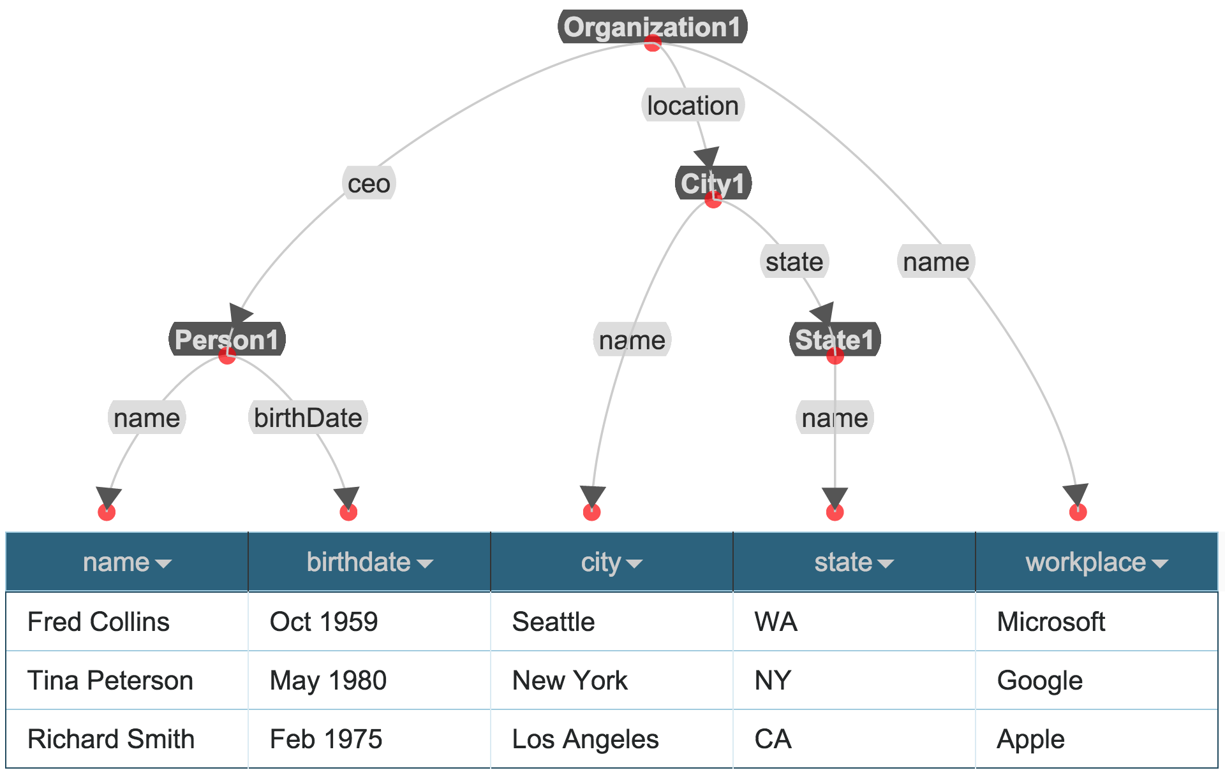
Result in Karma

Slide 25
Refining the Model
Impose constraints on Steiner Tree Algorithm
Change weight of selected links to ε
Add source and target of selected link to Steiner nodes
Correct Model
date

Slide 26
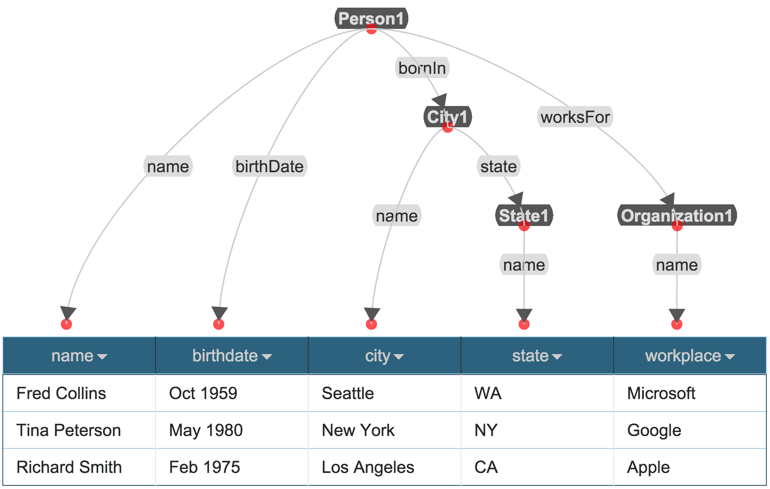
Final Semantic Model

Slide 27
Evaluation
Evaluation Dataset | EDM
# sources | 29
# classes in the ontologies | 119
# properties in the ontologies | 351
# nodes in the gold standard models | 473
# links in the gold standard models | 444
Measured the user effort in Karma to model the sources
Started with no training data
User actions
Assign/Change semantic types
Change relationships

Slide 28
Evaluation
source | columns | Choose Type | Change Link | Time (min)
s1 | 7 | 7 | 1 | 3
s2 | 12 | 5 | 2 | 6
s3 | 4 | 0 | 0 | 2
s4 | 17 | 5 | 6 | 8
s5 | 14 | 4 | 6 | 7
s6 | 18 | 4 | 4 | 7
s7 | 14 | 1 | 4 | 6
s8 | 6 | 0 | 4 | 3
… | … | … | … | …
s29 | 10 | 2 | 1 | 3
Total | 331 | 56 | 92 | 128
Avg. min per source: 4.4 minutes
Avg. # user actions per column: 148/331=0.44
Notes:
Out of the 56 manual assignments, 19 were for specifying semantic types that the system had never seen before.

Slide 29
Limitation
This approach does not learn the changes done by the user in relationships
User has to go through the refinement process each time

Slide 30
Learning Semantic Models
Contribution: exploiting known semantic models
to learn relationships

Slide 31
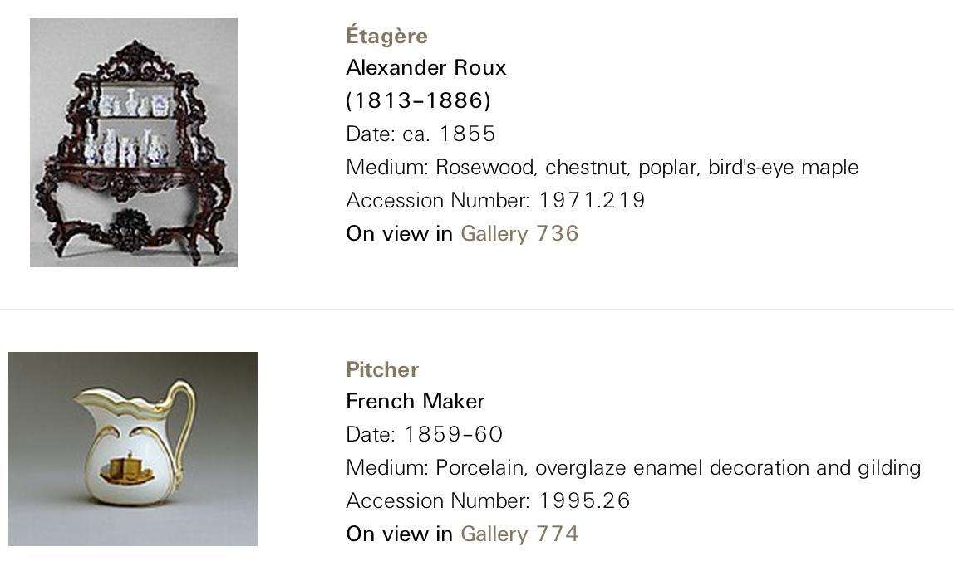
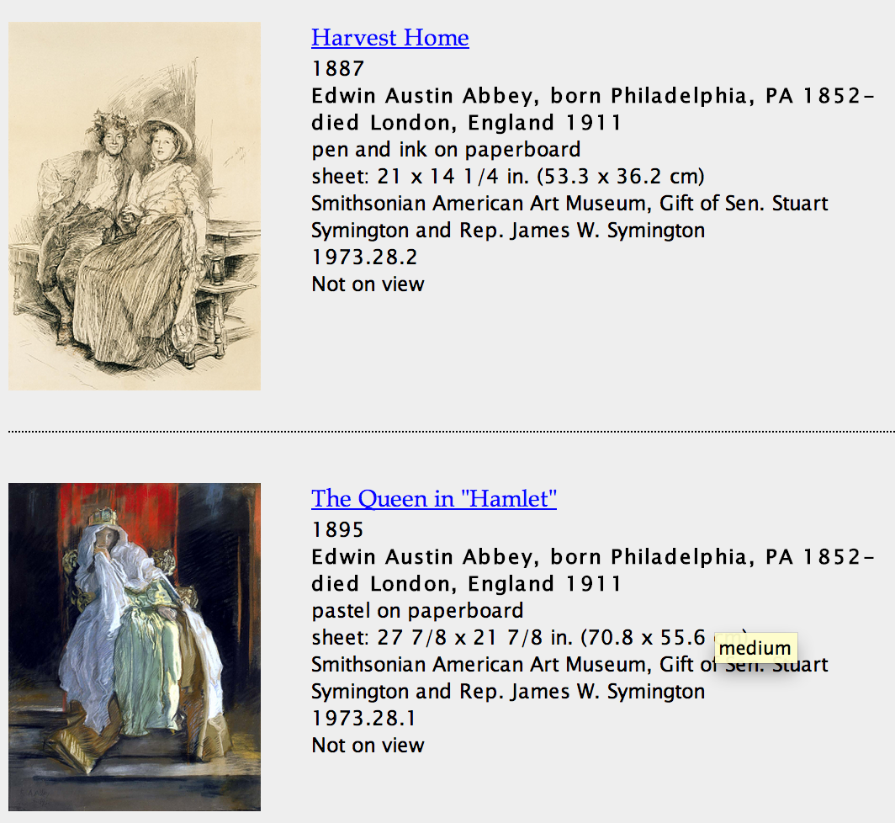
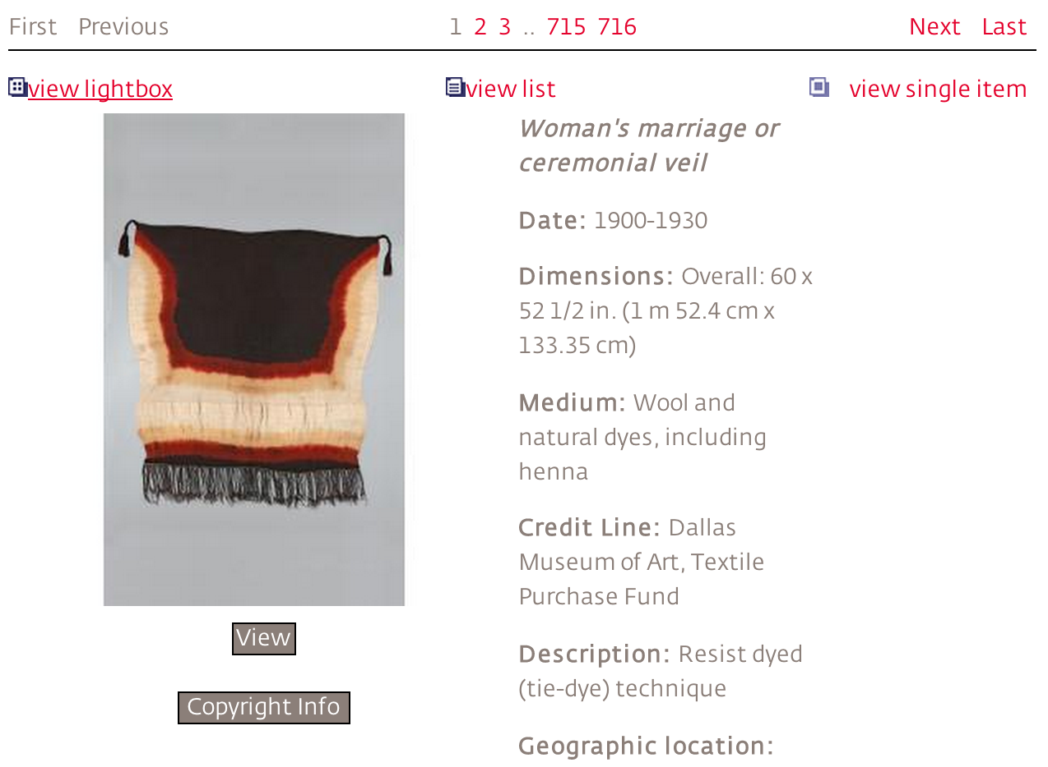
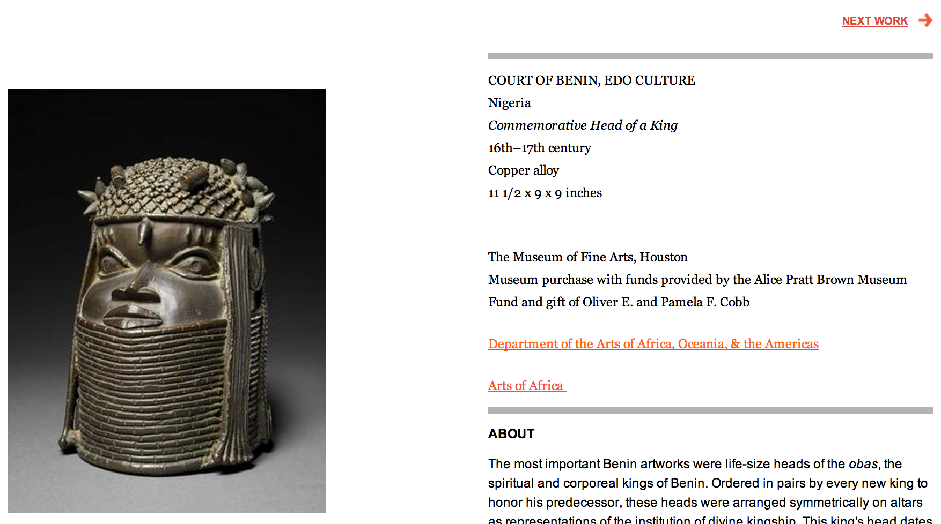
Main Idea
Sources in the same domain often have similar data
Exploit knowledge of known semantic models to hypothesize a semantic model for a new sources
Notes:
http://www.metmuseum.org/collection/the-collection-online/search?deptids=1&amp;pg=1&amp;ft=french&amp;od=on&amp;ao=on&amp;noqs=true
http://americanart.si.edu/collections/search/artwork/results/index.cfm?rows=10&fq=online_media_type%3A%22Images%22&q=Search+by+Artist%2C+Work%2C+or+Keyword&page=1&start=0&x=62&y=5
http://museum.dma.org:9090/emuseum/view/objects/asitem/2031/0/title-desc?t:state:flow=ff495581-e0d2-4334-bec9-19988f9eeb20
http://www.mfah.org/art/100-highlights/commemorative-head-king/
Leverage relationships in known semantic models to hypothesize relationships for new sources

Slide 32
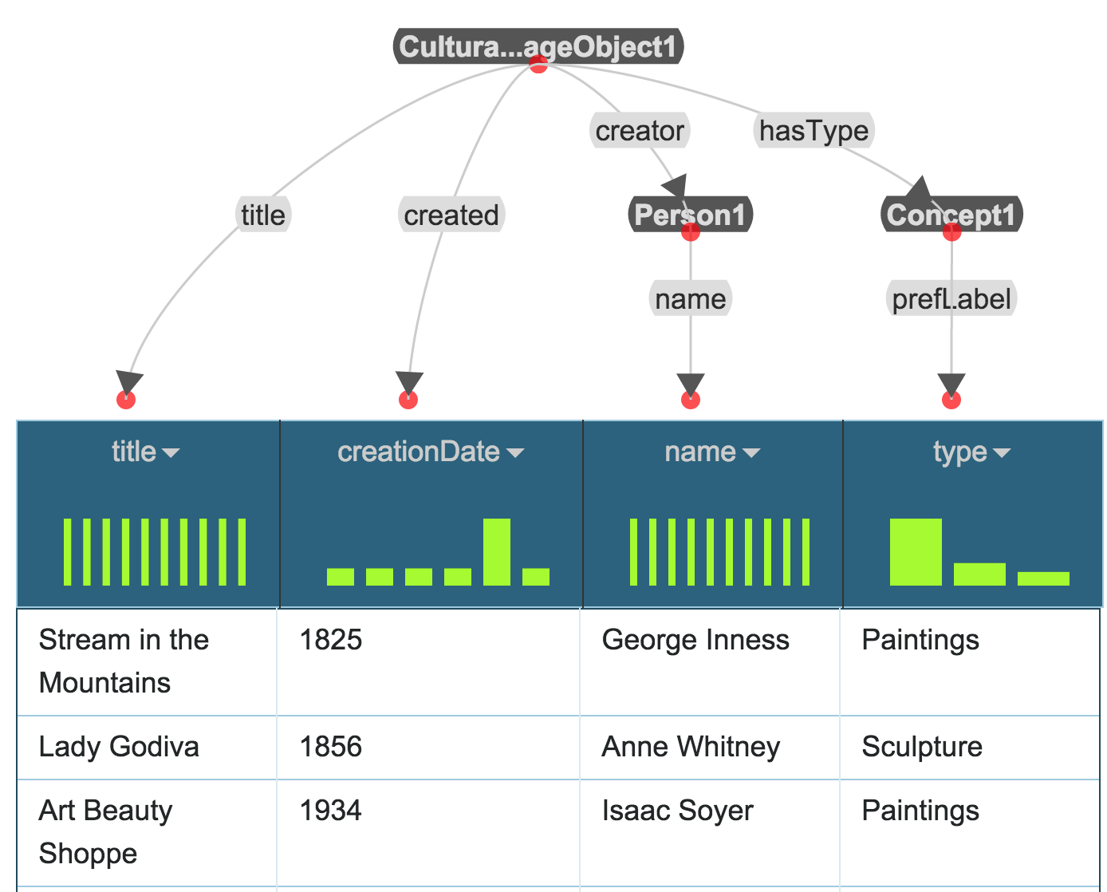
Example
Domain: Museum Data
Domain ontologies:
EDM
SKOS
FOAF
AAC
ORE
ElementsGr2
DCTerms
Source: Dallas Museum of Art ➔ dma(title,creationDate,name,type)

Slide 33
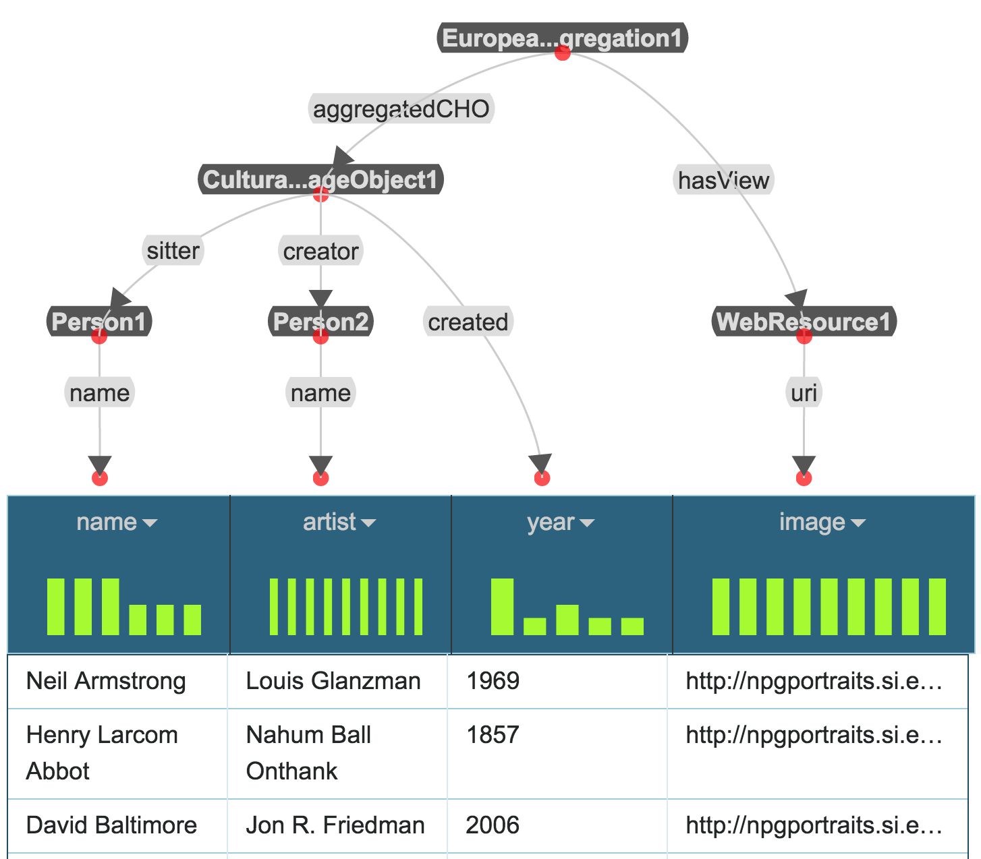
Example
Domain: Museum Data
Domain ontologies:
EDM
SKOS
FOAF
AAC
ORE
ElementsGr2
DCTerms
Source: National Portrait Gallery ➔ npg(name,artist,year,image)

Slide 34
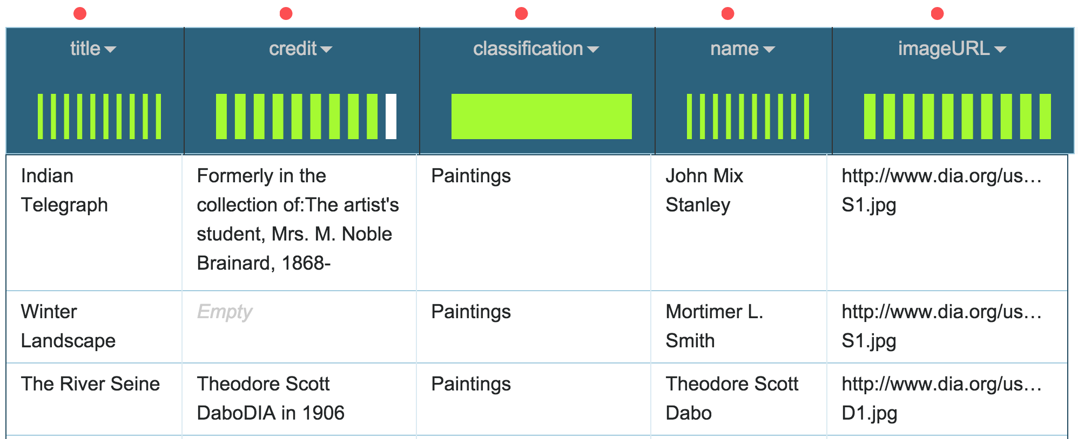
Example
Domain: Museum Data
Domain ontologies:
EDM
SKOS
FOAF
AAC
ORE
ElementsGr2
DCTerms
Source: Detroit Institute of Art ➔ dia(title,credit,classification,name,imageURL)
Goal: Automatically suggest a semantic model for dia

Slide 35
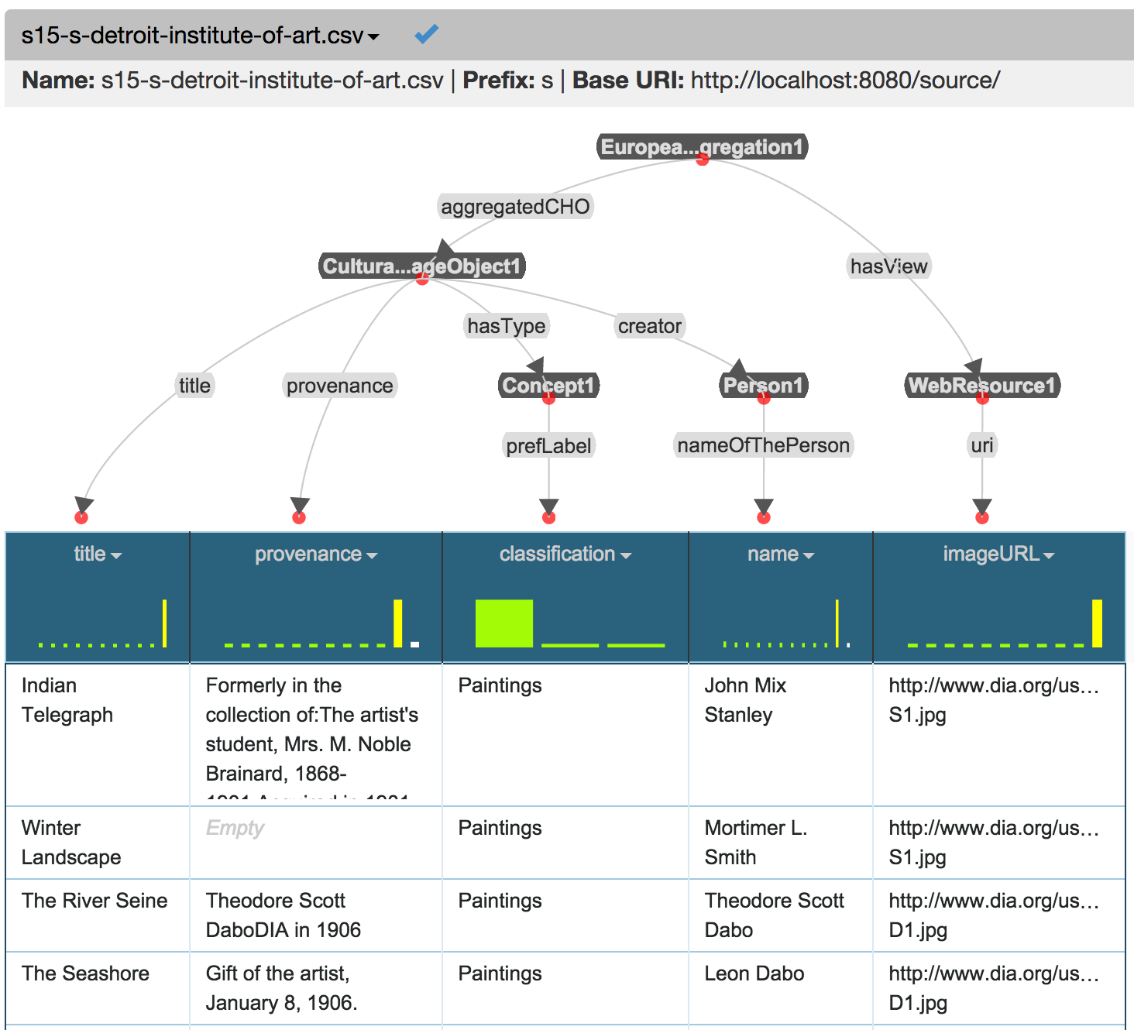

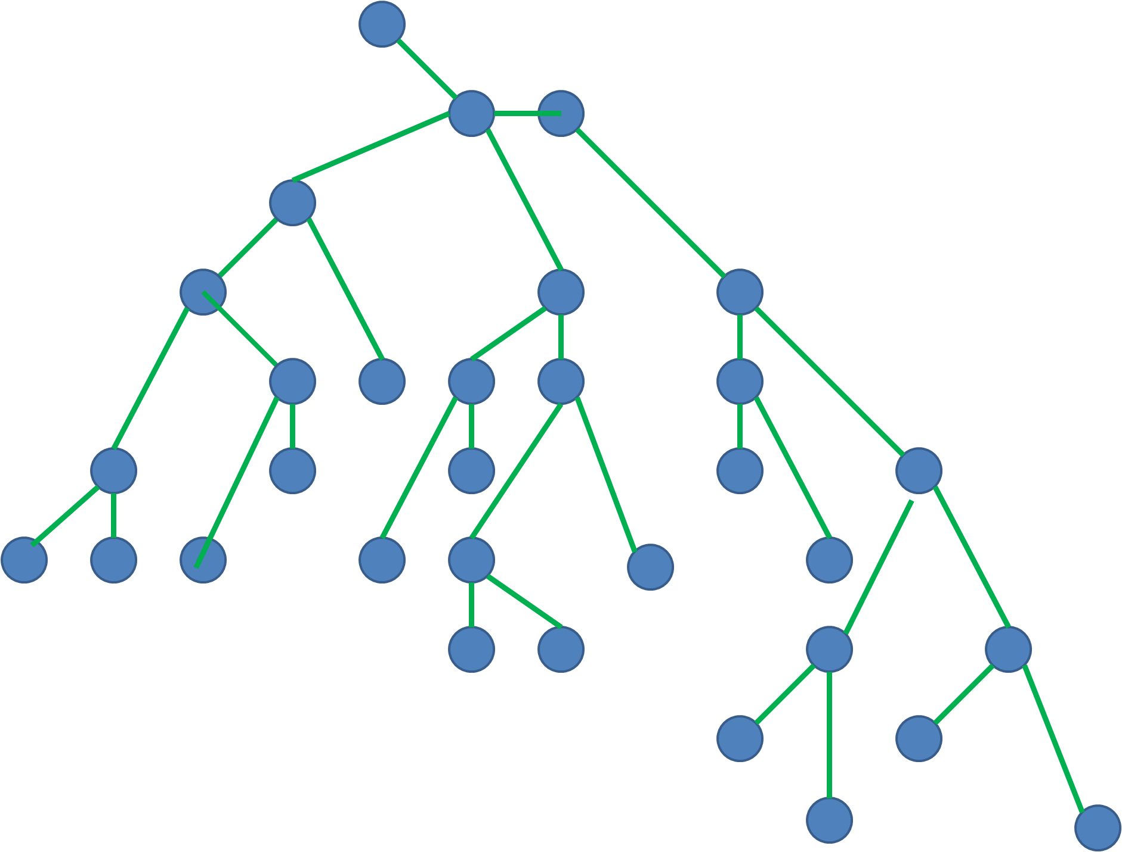
Approach [Taheriyan et al, ISWC 2013, ICSC 2014, JWS 2015]
Sample Data
Learn
Semantic Types
Generate Candidate Models
Construct a Graph
Domain Ontology
Rank Results
Known Semantic Models
Implemented in Karma

Slide 36
Approach
Input
Sample data from new source (S)
Domain Ontologies (O)
Known semantic models
1
Learn semantic types for attributes(s)
2
Construct Graph G=(V,E)
3
Generate mappings between attributes(S) and V
4
Generate and rank semantic models
Output
A ranked set of semantic models for S

Slide 37
Approach
Input
Sample data from new source (S)
Domain Ontologies (O)
Known semantic models
1
Learn semantic types for attributes(s)
Construct Graph G=(V,E)
Generate mappings between attributes(S) and V
Generate and rank semantic models
Output
A ranked set of semantic models for S

Slide 38
Learn Semantic Types
Learn Semantic Types for each attribute from its data
Pick top K semantic types according to their confidence values
dia(title,credit, classification,name,imageURL)
title | <aac:CulturalHeritageObject, dcterms:title> | 0.49
 | <aac:CulturalHeritageObject, rdfs:label> | 0.28
credit | <aac:CulturalHeritageObject, dcterms:provenance> | 0.83
 | <aac:Person, ElementsGr2:note> | 0.06
classification | <skos:Concept, skos:prefLabel> | 0.58
 | <skos:Concept, rdfs:label> | 0.41
name | <aac:Person, foaf:name> | 0.65
 | <fofa:Person, fofaf:name> | 0.32
imageURL | <foaf:Document, uri> | 0.47
 | <edm:WebResource, uri> | 0.40
Notes:
Semantic Type: <class_uri, property_uri>
Cosine similarity between TF/IDF vectors (for textual data) and statistical hypothesis testing (for numeric data)

Slide 39

Approach
Input
Sample data from new source (S)
Domain Ontologies (O)
Known semantic models
Learn semantic types for attributes(s)
2
Construct Graph G=(V,E)
Generate mappings between attributes(S) and V
Generate and rank semantic models
Output
A ranked set of semantic models for S

Slide 40
Build Graph G: Add Known Models
Annotate (tag) nodes and links with list of supporting models
Adjust weight based on the number of supporting models
dma
CulturalHeritageObject
dma
1
dma
1
dma
1
created
title
hasType
creator
dma
1
Concept
aac:Person
creationDate
title
dma
1
dma
1
prefLabel
name
type
name

Slide 41
Build Graph G: Add Known Models
Annotate (tag) nodes and links with list of supporting models
Adjust weight based on the number of tags
dma
npg
EuropeanaAggregation
npg
1
hasView
aggregatedCHO
WebResource
npg
1
npg
1
uri
CulturalHeritageObject
image
dma
npg
0.5
dma
1
dma
npg
0.5
npg
1
created
title
hasType
creator
sitter
dma
1
Concept
aac:Person
aac:Person
creationDate
dma
1
dma
npg
0.5
npg
1
title
prefLabel
name
name
type
name
name

Slide 42
Build Graph G: Add Semantic Types
title | <CulturalHeritageObject,title> <CulturalHeritageObject,label>
credit | <CulturalHeritageObject,provenance> <Person,note>
classification | <Concept,prefLabel> <Concept,label>
name | <aac:Person,name> <foaf:Person,name>
imageURL | <Document,uri> <WebResource,uri>
EuropeanaAggregation
npg
1
hasView
aggregatedCHO
WebResource
npg
1
npg
1
uri
CulturalHeritageObject
image
dma
npg
0.5
dma
1
dma
npg
0.5
npg
1
created
title
hasType
creator
sitter
dma
1
Concept
aac:Person
aac:Person
creationDate
dma
1
dma
npg
0.5
npg
1
title
prefLabel
name
name
type
name
name

Slide 43
Build Graph G: Add Semantic Types
title | <CulturalHeritageObject,title> <CulturalHeritageObject,label>
credit | <CulturalHeritageObject,provenance> <Person,note>
classification | <Concept,prefLabel> <Concept,label>
name | <aac:Person,name> <foaf:Person,name>
imageURL | <Document,uri> <WebResource,uri>
EuropeanaAggregation
title
npg
1
hasView
aggregatedCHO
WebResource
label
npg
1
npg
1
uri
CulturalHeritageObject
image
dma
npg
0.5
dma
1
dma
npg
0.5
npg
1
created
title
hasType
creator
sitter
dma
1
Concept
aac:Person
aac:Person
creationDate
dma
1
dma
npg
0.5
npg
1
title
prefLabel
name
name
type
name
name

Slide 44
Build Graph G: Add Semantic Types
title | <CulturalHeritageObject,title> <CulturalHeritageObject,label>
credit | <CulturalHeritageObject,provenance> <Person,note>
classification | <Concept,prefLabel> <Concept,label>
name | <aac:Person,name> <foaf:Person,name>
imageURL | <Document,uri> <WebResource,uri>
EuropeanaAggregation
title
npg
1
credit
hasView
aggregatedCHO
WebResource
label
npg
1
provenance
npg
1
uri
CulturalHeritageObject
image
Document
dma
npg
0.5
dma
1
dma
npg
0.5
npg
1
created
title
hasType
creator
sitter
uri
dma
1
Concept
aac:Person
aac:Person
foaf:Person
creationDate
imageURL
dma
1
dma
npg
0.5
npg
1
title
prefLabel
label
name
note
name
note
name
type
classification
name
credit
name
credit
name

Slide 45
Build Graph G: Expand with Paths from Ontology
Assign a high weight to the links coming from the ontology
EuropeanaAggregation
page
title
1000
npg
1
1000
credit
aggregates
1000
hasView
aggregatedCHO
subClassOf
WebResource
label
npg
1
1000
Aggregation
npg
1
isShownAt
provenance
aggregates
uri
1000
CulturalHeritageObject
creator
image
Document
dma
npg
0.5
dma
1
dma
npg
0.5
1000
npg
1
created
title
hasType
creator
sitter
uri
dma
1
Concept
aac:Person
aac:Person
foaf:Person
creationDate
imageURL
dma
1
dma
npg
0.5
npg
1
title
prefLabel
label
name
note
name
note
name
type
classification
name
credit
name
credit
name

Slide 46
Approach
Input
Sample data from new source (S)
Domain Ontologies (O)
Known semantic models
Learn semantic types for attributes(s)
Construct Graph G=(V,E)
3
Generate mappings between attributes(S) and V
Generate and rank semantic models
Output
A ranked set of semantic models for S

Slide 47
Map Source Attributes to the Graph
title | <CulturalHeritageObject,title> <CulturalHeritageObject,label>
credit | <CulturalHeritageObject,provenance> <Person,note>
classification | <Concept,prefLabel> <Concept,label>
name | <aac:Person,name> <foaf:Person,name>
imageURL | <Document,uri> <WebResource,uri>
EuropeanaAggregation
page
title
1000
npg
1
1000
credit
aggregates
1000
hasView
aggregatedCHO
subClassOf
WebResource
label
npg
1
1000
Aggregation
npg
1
isShownAt
provenance
aggregates
uri
1000
CulturalHeritageObject
creator
image
Document
dma
npg
0.5
dma
1
dma
npg
0.5
1000
npg
1
created
title
hasType
creator
sitter
uri
dma
1
Concept
aac:Person
aac:Person
foaf:Person
creationDate
imageURL
dma
1
dma
npg
0.5
npg
1
title
prefLabel
label
name
note
name
note
name
type
classification
name
credit
name
credit
name

Slide 48
Map Source Attributes to the Graph
title | <CulturalHeritageObject,title> <CulturalHeritageObject,label>
credit | <CulturalHeritageObject,provenance> <Person,note>
classification | <Concept,prefLabel> <Concept,label>
name | <aac:Person,name> <foaf:Person,name>
imageURL | <Document,uri> <WebResource,uri>
EuropeanaAggregation
page
title
1000
npg
1
1000
credit
aggregates
1000
hasView
aggregatedCHO
subClassOf
WebResource
label
npg
1
1000
Aggregation
npg
1
isShownAt
provenance
aggregates
uri
1000
CulturalHeritageObject
creator
image
Document
dma
npg
0.5
dma
1
dma
npg
0.5
1000
npg
1
created
title
hasType
creator
sitter
uri
dma
1
Concept
aac:Person
aac:Person
foaf:Person
creationDate
imageURL
dma
1
dma
npg
0.5
npg
1
title
prefLabel
label
name
note
name
note
name
type
classification
name
credit
name
credit
name

Slide 49
Map Source Attributes to the Graph
title | <CulturalHeritageObject,title> <CulturalHeritageObject,label>
credit | <CulturalHeritageObject,provenance> <Person,note>
classification | <Concept,prefLabel> <Concept,label>
name | <aac:Person,name> <foaf:Person,name>
imageURL | <Document,uri> <WebResource,uri>
EuropeanaAggregation
page
title
1000
npg
1
1000
credit
aggregates
1000
hasView
aggregatedCHO
subClassOf
WebResource
label
npg
1
1000
Aggregation
npg
1
isShownAt
provenance
aggregates
uri
1000
CulturalHeritageObject
creator
image
Document
dma
npg
0.5
dma
1
dma
npg
0.5
1000
npg
1
created
title
hasType
creator
sitter
uri
dma
1
Concept
aac:Person
aac:Person
foaf:Person
creationDate
imageURL
dma
1
dma
npg
0.5
npg
1
title
prefLabel
label
name
note
name
note
name
type
classification
name
credit
name
credit
name

Slide 50
Scalability Issue
Multiple mappings from attributes(S) to nodes of G
Each attribute has more than one semantic type
Multiple matches for each semantic type
Not feasible to generate all possible mappings
The size of graph may be large
The source may have many attributes
Exponential in terms of number of attributes
N attributes, M matches for each → M^{N} mappings

Slide 51
Prune the Mappings
Score the partial mappings after mapping each attribute
Coherence: number of nodes in a mapping that belong to same component
Confidence: average confidence of semantic types in m
Score = arithmetic mean of coherence and confidence
Beam Search
Keep only top K mappings after mapping each attribute
Number of mappings will not exceed a fixed size after mapping each attribute

Slide 52
Approach
Input
Sample data from new source (S)
Domain Ontologies (O)
Known semantic models
Learn semantic types for attributes(s)
Construct Graph G=(V,E)
Generate mappings between attributes(S) and V
4
Generate and rank semantic models
Output
A ranked set of semantic models for S

Slide 53
Generate Semantic Models
Compute Steiner tree for each mapping
A minimal tree connecting nodes of mapping
A customization of BANKS algorithm [Bhalotia et al., 2002]
Our algorithm considers both coherence and popularity
Each tree is a candidate model
Rank the models based on coherence and cost
Notes:
Keyword Searching and Browsing in Databases using BANKS

Slide 54
Why Coherence is Important?
Known Models
organizer
location
bornIn
bornIn
Person
Event
Place
Person
Place
Person
Place
s1
s2
s3

Slide 55
Why Coherence is Important?
Known Models
organizer
location
bornIn
bornIn
Person
Event
Place
Person
Place
Person
Place
s1
s2
s3
organizer
location
1
s1
1
s1
Graph
Person
Event
Place
0.5
bornIn
s2, s3

Slide 56
Why Coherence is Important?
Known Models
organizer
location
bornIn
bornIn
Person
Event
Place
Person
Place
Person
Place
s1
s2
s3
organizer
location
Person
1
1
Semantic types
of a new source
Graph
s1
s1
Person
Event
Place
Event
0.5
bornIn
Place
s2, s3

Slide 57
Why Coherence is Important?
Known Models
organizer
location
bornIn
bornIn
Person
Event
Place
Person
Place
Person
Place
s1
s2
s3
organizer
location
Person
1
1
Semantic types
of a new source
Graph
s1
s1
Person
Event
Place
Event
0.5
bornIn
Place
s2, s3
Top 3 Steiner trees
organizer
location
organizer
location
1
1
s1
1
s1
1
s1
s1
Person
Event
Place
Person
Event
Place
Person
Event
Place
0.5
bornIn
0.5
bornIn
s2, s3
s2, s3

Slide 58
Example Mapping
title | <CulturalHeritageObject,title> <CulturalHeritageObject,label>
credit | <CulturalHeritageObject,provenance> <Person,note>
classification | <Concept,prefLabel> <Concept,label>
name | <aac:Person,name> <foaf:Person,name>
imageURL | <Document,uri> <WebResource,uri>
EuropeanaAggregation
page
title
1000
npg
1
1000
credit
aggregates
1000
hasView
aggregatedCHO
subClassOf
WebResource
npg
1
1000
label
Aggregation
npg
1
isShownAt
provenance
aggregates
uri
1000
CulturalHeritageObject
creator
image
Document
dma
npg
0.5
dma
1
dma
npg
0.5
1000
npg
1
created
title
hasType
creator
sitter
uri
dma
1
Concept
aac:Person
aac:Person
foaf:Person
creationDate
imageURL
dma
1
dma
npg
0.5
npg
1
title
prefLabel
label
name
note
name
note
name
type
classification
name
credit
name
credit
name

Slide 59
Steiner Tree
title | <CulturalHeritageObject,title> <CulturalHeritageObject,label>
credit | <CulturalHeritageObject,provenance> <Person,note>
classification | <Concept,prefLabel> <Concept,label>
name | <aac:Person,name> <foaf:Person,name>
imageURL | <Document,uri> <WebResource,uri>
EuropeanaAggregation
page
title
1000
npg
1
1000
credit
aggregates
1000
hasView
aggregatedCHO
subClassOf
WebResource
npg
1
1000
label
Aggregation
npg
1
isShownAt
provenance
aggregates
uri
1000
CulturalHeritageObject
creator
image
Document
dma
npg
0.5
dma
1
dma
npg
0.5
1000
npg
1
created
title
hasType
creator
sitter
uri
dma
1
Concept
aac:Person
aac:Person
foaf:Person
creationDate
imageURL
dma
1
dma
npg
0.5
npg
1
title
prefLabel
label
name
note
name
note
name
type
classification
name
credit
name
credit
name

Slide 60
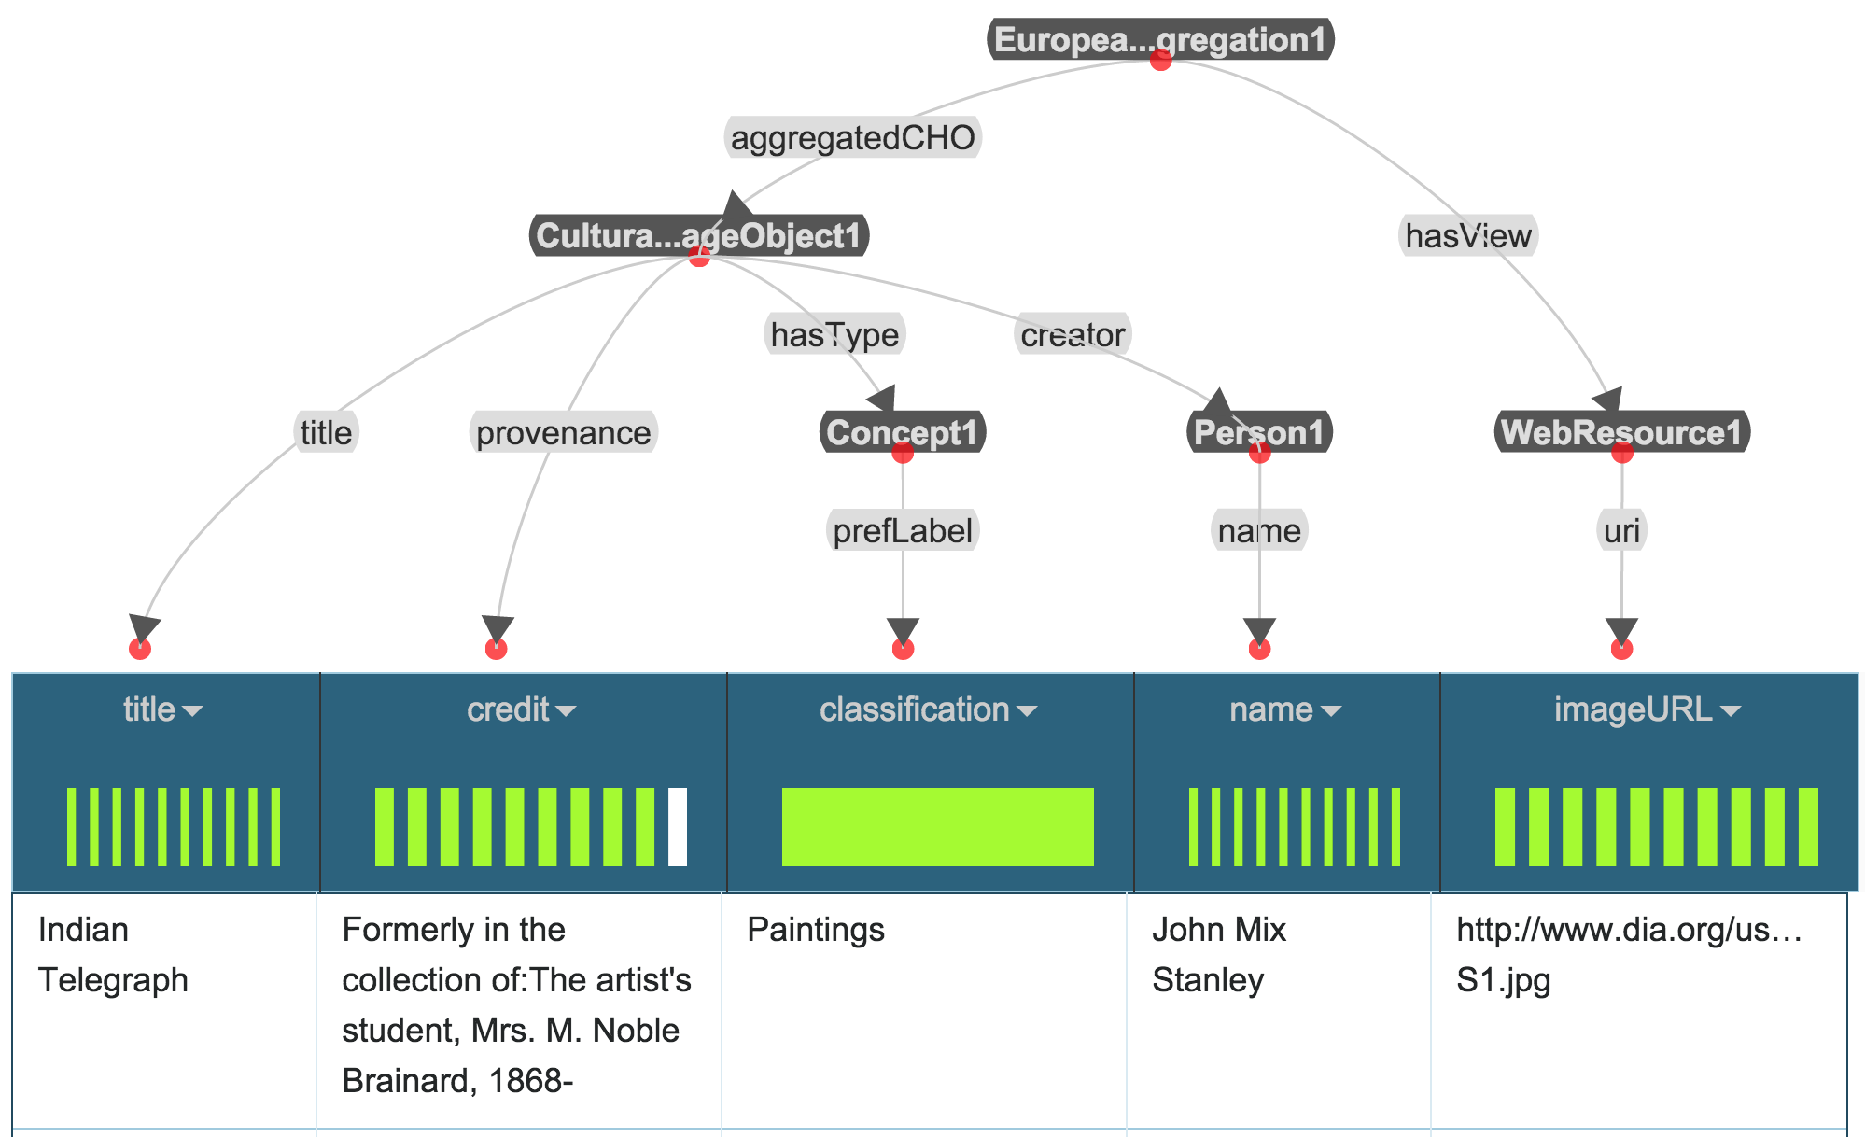
Final Model in Karma
Domain: Museum Data
Domain ontologies:
EDM
SKOS
FOAF
AAC
ORE
ElementsGr2
DCTerms
Source: Detroit Institute of Art ➔ dia(title,credit,classification,name,imageURL)

Slide 61
Evaluation
Evaluation Dataset | EDM | CRM
# sources | 29 | 29
# classes in the ontologies | 119 | 147
# properties in the ontologies | 351 | 409
# nodes in the gold standard models | 473 | 812
# links in the gold standard models | 444 | 785
Compute precision and recall between learned models and correct models
How many of the learned relationships are correct?
How many of the correct relationships are learned?
rel(sm) is the set of triples <source, link, target> in the semantic model
Notes:
ds
edm
dscrm
#data source
29
29
#classes in the domain ontologies
119
147
#properties in the domain ontologies
351
409
#nodes in the gold-standard models
473
812
#data nodes in the gold-standard models
331
418
#class nodes in the gold-standard models
142
394
#links in the gold-standard models
444
785

Slide 62
Example
Artwork
Museum
location
founder
location
creator
Museum
Person
Artwork
Person
correct model
learned model
<Artwork,location,Museum>
<Artwork,creator,Person>
<Museum,founder,Person>
<Artwork,location,Museum>
Precision: 0.5
Recall: 0.5

Slide 63
Experiment 1
correct semantic types are given
EDM
CRM
Notes:
edm: 113 links, crm: 367 links

Slide 64
Experiment 1
correct semantic types are given
EDM
CRM

Slide 65
Experiment 2
learn semantic types, pick top K candidates
EDM
CRM

Slide 66
Experiment 2
learn semantic types, pick top K candidates
EDM
CRM
Notes:
edm: recall: 71->77
precidion: 71->79
crm: recall: 62->69
precidion: 65->71

Slide 67
Experiment 2
learn semantic types, pick top K candidates
EDM
CRM

Slide 68
Limitation
Lack of sufficient known semantic models is some domains

Slide 69
Inferring Semantic Relations from Linked Open Data
Contribution: leveraging graph patterns in LOD
to infer relationships

Slide 70
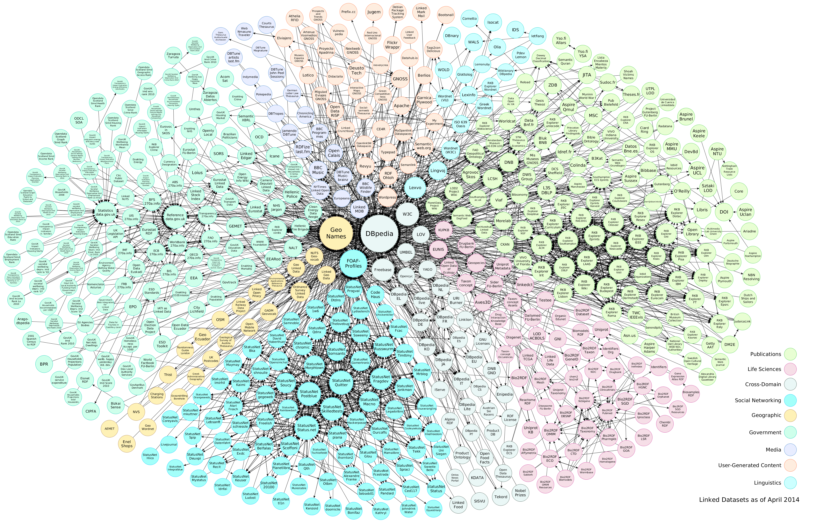
Idea
There is a huge amount of linked data available in many domains (RDF format)
Use LOD when there is no known semantic model
Exploit the relationships between instances

Slide 71

Approach [Taheriyan et al, COLD 2015]
Sample Data
Learn
Semantic Types
Generate Candidate Models
Construct a Graph
Domain Ontology
Rank Results
Extract Patterns
Linked Open Data

Slide 72
LOD Patterns
isi:mohsen
rdf:type
foaf:Person
LOD Fragment
foaf:name
Mohsen Taheriyan
foaf:baed_near
dbpedia:Los_Angeles
rdf:type
dbo:Location
rdf:type
dbo:PopulatedPlace
foaf:name
City of Los Angeles

Slide 73
LOD Patterns
isi:mohsen
rdf:type
foaf:Person
LOD Fragment
foaf:name
Mohsen Taheriyan
foaf:baed_near
dbpedia:Los_Angeles
rdf:type
dbo:Location
rdf:type
dbo:PopulatedPlace
foaf:name
City of Los Angeles
Patterns
foaf:based_near
foaf:based_near
foaf:Person
dbo:Location
foaf:Person
dbo:PopulatedPlace

Slide 74
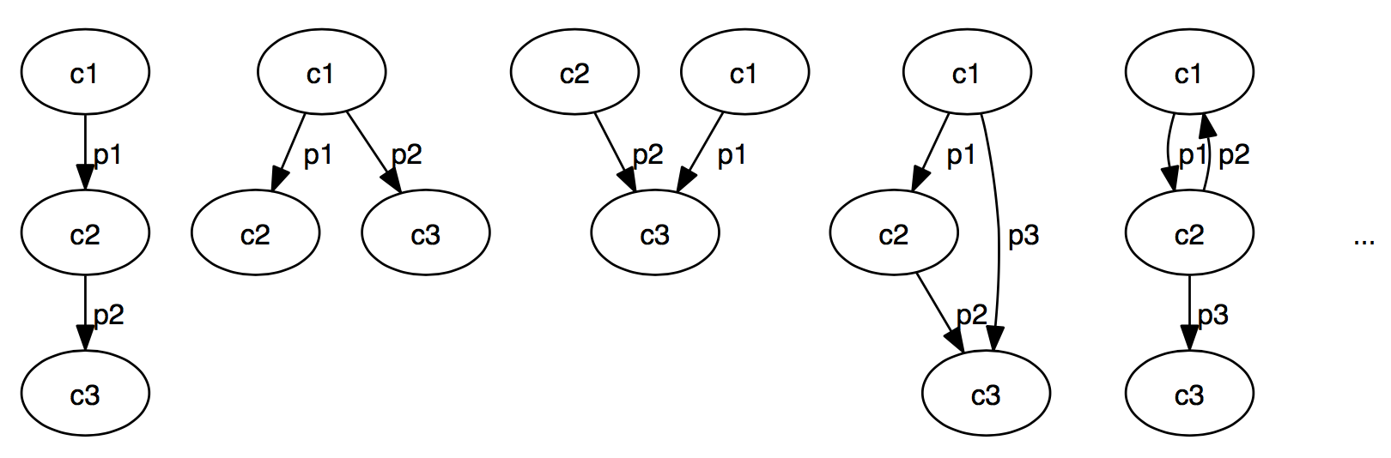
LOD Patterns
Example semantic types:
C1.x, C2.y, C3.z (C1, C2, C3: ontology classes)
Consider only tree patterns
Limit the length of the patterns

Slide 75
Extracting Patterns
Use SPARQL to query RDF data
Example: patterns with length 1
SELECT DISTINCT ?c1 ?p ?c2 (COUNT(*) as ?count)
WHERE { ?x ?p ?y.
?x rdf:type ?c1.
?y rdf:type ?c2.
FILTER (?x != ?y).}
GROUP BY ?c1 ?p ?c2
ORDER BY DESC(?count);

Slide 76
Evaluation
Linked data: 3,398,350 triples published by Smithsonian American Art Museum
Correct semantic types given
Extracted patterns of length 1 and 2
Evaluation Dataset | CRM
# sources | 29
# classes in the ontologies | 147
# properties in the ontologies | 409
# nodes in the gold standard models | 812
# links in the gold standard models | 785
background knowledge | precision | recall | time (s)
domain ontology | 0.07 | 0.05 | 0.17
domain ontology + patterns of length 1 | 0.65 | 0.55 | 0.75
domain ontology + patterns of length 1 and 2 | 0.78 | 0.70 | 0.46

Slide 77
Related Work

Slide 78
Related Work
Mapping databases and spreadsheets to ontologies
Mapping languages: D2R [Bizer, 2003], D2RQ [Bizer and Seaborne, 2004], R2RML [Das et al., 2012]
Tools: RDOTE [Vavliakis et al., 2010], RDF123 [Han et al., 2008], XLWrap [Langegger and Woß, 2009]
String similarity between column names and ontology terms [Polfliet and Ichise, 2010]
Understand semantics of Web tables
Use column headers and cell values to find the labels and relations from a database of labels and relations populated from the Web [Wang et al., 2012] [Limaye et al., 2010] [Venetis et al., 2011]
Exploit Linked Open Data (LOD)
Link the values to the entities in LOD to find the types of the values and their relationships [Muoz et al., 2013] [Mulwad et al., 2013]
Semantic annotation of Web services
Languages: SAWSDL [Farrell and Lausen, 2007]
Tools: SWEET [Maleshkova et al., 2009]
Annotate input and output parameters [Heß et al., 2003] [Lerman et al., 2006] [Saquicela e al., 2011]
Learn Semantic Definitions of Online Information Sources [Carman, Knoblock, 2007]
Learns LAV rules from known sources
Only learns descriptions that are conjunctive combinations of known descriptions
Notes:
An et al. [An et al., 2007] generate declarative mapping expressions between two tables with different schemas starting from element correspondences. They create a graph from the conceptual model (CM) of each schema and then suggest plausible mappings by exploring low-cost Steiner trees that connect those nodes in the CM graph that have attributes participating in element correspondences.
Known: Table 1, CM graph 1, marked nodes (nodes in CM1 corresponding to columns), s-tree1: a semantic tree that expresses the correct semantic of Table1 by connecting its marked nodes in CM1
Known: Table 2, CM graph 2, marked nodes (nodes in CM2 corresponding to columns), s-tree2: a semantic tree that expresses the correct semantic of Table2 by connecting its marked nodes in CM2
Goal: Find a mapping from Table1 to Table2 (a subgraph of CM1, called CSG1, to a subgraph of CM2, called CSG2
Method: If CSG2 is known (e.g., it is the s-tree2), find the Steiner tree in CM1 connecting marked nodes, preferring the edges from s-tree1
Strong assumption: we know semantic of each table (s-trees)
Use-case example: Table 1 has 10 columns with a large s-tree, and table 2 has only 3 columns. This approach finds a minimal tree in CM1 (maximum overlap with s-tree1) that connects the marked nodes of table1 corresponding to the marked nodes of table2.

Slide 79
Discussion & Future Work

Slide 80
Discussion
Contributions
Semi-automatically model the relationships
Learn semantic models from previous models
Infer semantic relationships from LOD
Provide explicit semantics for large portion of LOD
Help to publish consistent RDF data
Applications
VIVO
Smithsonian American Art Museum
DIG for DARPA’s Memex project
Notes:
A possible direction for future work is to perform user evaluations to measure the quality of the models produced using learning algorithms.
It is much harder for users to model a source from scratch
A large portion of the data in the LOD cloud is published directly from existing databases using tools such as D2R. This conversion process uses the structure of the data as it is organized in the database. There is often no explicit semantic description of the contents of a source and it requires a significant effort if one wants to do more than simply convert a database into RDF
- Often, there are multiple correct ways to model the same type of data. For example, users can use Dublin Core and FOAF to model the creator relationship between a person and an object (dcterms:creator and foaf:maker). A community is better served when all the data with the same semantics is modeled using the same classes and properties. Our work encourages consistency because our learning algorithms bias the selection of classes and properties towards those used more frequently in existing models.

Slide 81
Future Work
Improve the quality of semantic labeling
Use LOD to learn semantic types
Extract longer patterns from LOD
Publish linked data
Transform the data to a common vocabulary
Linking entities across different datasets

Slide 82
Backup Slides

Slide 83

VIVO
VIVO is a system to build researcher networks across institutions
Used Karma to map the data about USC faculty to VIVO ontology and publish it as RDF
VIVO ingest the RDF data
Video

Slide 84
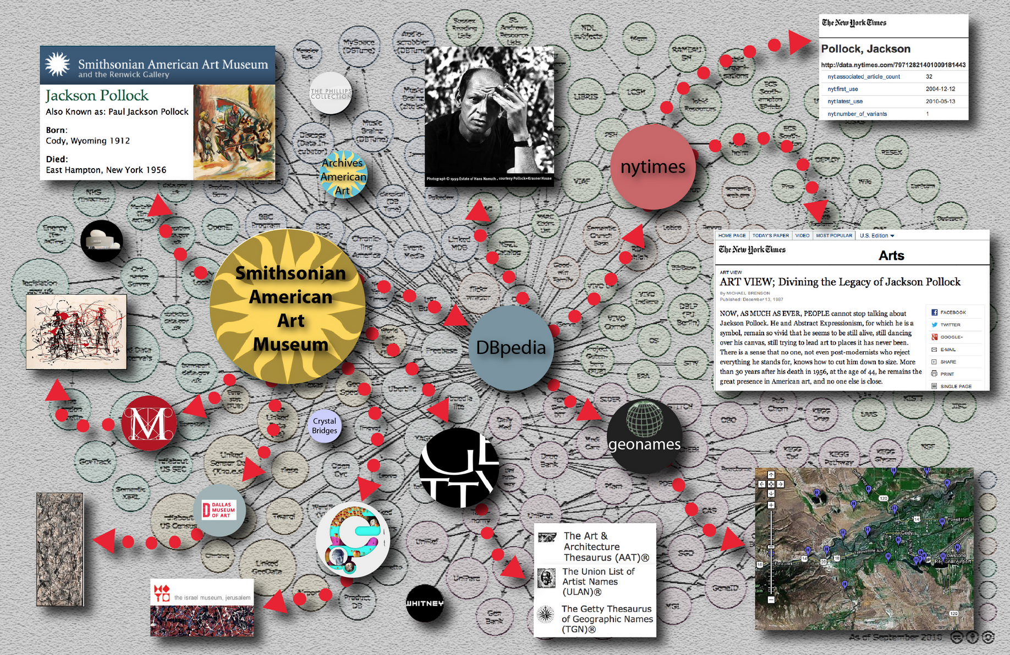
Smithsonian American Art Museum
Used Karma to convert data of 44000 museum objects to Linked Open Data
Modeled according to Europeana Data Model (EDM)
Linked the generated RDF to DBPedia, ULAN, NY Times Linked Data
News: USC press, Viterbi
Video
Notes:
linked to DBpedia, the Getty Union List of Artist Names (ULAN)® and the NY Times Linked Data

Slide 85
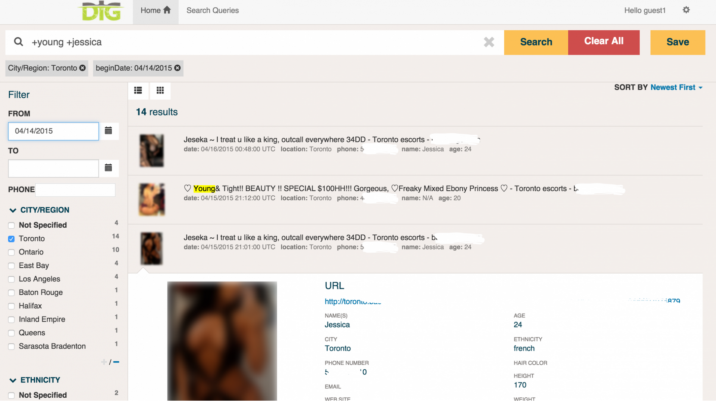
DIG
DIG: Domain-specific Insight Graphs
Building and using knowledge graphs to combat human trafficking
Used Karma to map extracted data and structured sources to shared domain ontology
News: Forbes, Wired.co.uk
Notes:
linked to DBpedia, the Getty Union List of Artist Names (ULAN)® and the NY Times Linked Data

Slide 86
Related Work
Schema matching
Finds correspondence between elements of the source and target schemas
Example: iMAP [Dhamankar et al., 2004]
Schema mapping
Generate declarative mappings expressible as queries in SQL or Datalog
Example: Clio [Fagin et al., 2009]
Mapping databases and spreadsheets to ontologies
Mapping languages: D2R [Bizer, 2003], D2RQ [Bizer and Seaborne, 2004], R2RML [Das et al., 2012]
Tools: RDOTE [Vavliakis et al., 2010], RDF123 [Han et al., 2008], XLWrap [Langegger and Woß, 2009]
String similarity between column names and ontology terms [Polfliet and Ichise, 2010]
Understand semantics of Web tables
Use column headers and cell values to find the labels and relations from a database of labels and relations populated from the Web [Wang et al., 2012] [Limaye et al., 2010] [Venetis et al., 2011]
Notes:
An et al. [An et al., 2007] generate declarative mapping expressions between two tables with different schemas starting from element correspondences. They create a graph from the conceptual model (CM) of each schema and then suggest plausible mappings by exploring low-cost Steiner trees that connect those nodes in the CM graph that have attributes participating in element correspondences.
Known: Table 1, CM graph 1, marked nodes (nodes in CM1 corresponding to columns), s-tree1: a semantic tree that expresses the correct semantic of Table1 by connecting its marked nodes in CM1
Known: Table 2, CM graph 2, marked nodes (nodes in CM2 corresponding to columns), s-tree2: a semantic tree that expresses the correct semantic of Table2 by connecting its marked nodes in CM2
Goal: Find a mapping from Table1 to Table2 (a subgraph of CM1, called CSG1, to a subgraph of CM2, called CSG2
Method: If CSG2 is known (e.g., it is the s-tree2), find the Steiner tree in CM1 connecting marked nodes, preferring the edges from s-tree1
Strong assumption: we know semantic of each table (s-trees)
Use-case example: Table 1 has 10 columns with a large s-tree, and table 2 has only 3 columns. This approach finds a minimal tree in CM1 (maximum overlap with s-tree1) that connects the marked nodes of table1 corresponding to the marked nodes of table2.

Slide 87
Related Work
Exploit Linked Open Data (LOD)
Link the values to the entities in LOD to find the types of the values and their relationships [Muoz et al., 2013] [Mulwad et al., 2013]
Semantic annotation of Web services
Languages: SAWSDL [Farrell and Lausen, 2007]
Tools: SWEET [Maleshkova et al., 2009]
Annotate input and output parameters [Heß et al., 2003] [Lerman et al., 2006] [Saquicela e al., 2011]
Learn Semantic Definitions of Online Information Sources [Carman, Knoblock, 2007]
Learns LAV rules from known sources
Only learns descriptions that are conjunctive combinations of known descriptions
Our approach
Semi-automatically learn types and relationships [Knoblock et al., 2012]
Integrated into Karma: used to model APIs [Taheriyan et al., 2012] and publish RDF [Szekely et al., 2013]
The automatic approach learns structure of previously modeled sources [Taheriyan et al., 2013, 2014, 2015] and infer the relationships from LOD [Taheriyan 2015]

